Slide 1
IBM Skillsbuild internship
PROJECT PRESENTATION
Sai Narayana B
(STU61bafdcbbdeea1639644619)

Slide 2
Secure Image Steganography with AES Encryption

Slide 3

Name : Sai Narayana B
SkillsBuild Email ID : chroniclessai@gmail.com
College Name : SRM Institute of Science and Technology, Tiruchirappalli
College State : Tamilnadu
Domain : Cybersecurity
Start Date : 13-October-2023
End Date : 26-November-2023

Slide 4
AGENDA
Problem Statement
Overview
Target Audience
Solution and its Value
​Unique features & aspects
Modelling Techniques
Result
Links

Slide 5
PROBLEM STATEMENT
Develop a secure image steganography system with AES encryption to enable the covert embedding and extraction of confidential text messages within digital images. The system should employ techniques such as LSB steganography to conceal information within image pixels and AES encryption to ensure the confidentiality and integrity of the hidden data.
This project aims to explore the intersection of information security and image processing, providing a robust and efficient method for secure communication through visually imperceptible image alterations.

Slide 6
Overview
This project aims to develop a secure system for covert communication by embedding confidential text messages within digital images. Leveraging LSB steganography and AES encryption, the solution ensures both concealment and retrieval of information while maintaining the integrity and confidentiality of the hidden data.
The objectives include implementing robust steganographic embedding, integrating AES encryption, providing a user-friendly interface, and demonstrating the effectiveness of the system in securely managing text communication within images.
The project contributes to information security by exploring practical applications of steganography and encryption in the realm of secure image-based communication.

Slide 7
Target audience
Individual Users
Business Professionals
Security-Conscious Organizations
Characteristics: Everyday users valuing personal privacy.
Needs: Secure communication for personal matters.
Benefits: Confidential exchange of sensitive information in a user-friendly manner.
Characteristics: Professionals operating in business environments.
Needs: Confidential communication for business-sensitive matters.
Benefits: Secure exchange of information, reducing the risk of interception.
Characteristics: Organizations with a strong emphasis on data security.
Needs: Robust security measures for confidential communication.
Benefits: Multi-layered security through steganography and AES encryption, adaptable to various secure communication scenarios.

Slide 8
Solution & value
Confidential Communication:
Solution: Robust LSB steganography and AES encryption.
Value: Enables covert exchange of sensitive information within images.
User-Friendly Experience:
Solution: Intuitive interface.
Value: Makes secure communication accessible to users with varying technical expertise.
Enhanced Data Security:
Solution: Multi-layered security through steganography and AES encryption.
Value: Ensures confidentiality and integrity of hidden data.
Versatile Application:
Solution: Applicable in personal and professional scenarios.
Value: Adaptable to diverse secure communication needs.

Slide 9
Unique features & aspects
Innovative Features
Remarkable Aspects
Advanced Steganography:
Customized LSB method for imperceptible data embedding.
Dynamic AES Encryption:
Implements dynamic encryption with unique keys based on user input.
User-Driven Interface:
Allows flexible image and text customization.
GUI implementation:
Includes a real-time graphical user interface
Adaptability:
Tailored for personal and professional use.
Strategic Password-Based AES:
Uses user-generated passwords for dynamic encryption.
Balanced Security and User-Friendliness:
Achieves a balance between robust security and a user-friendly interface.

Slide 10
MODELLING TECHNIQUES
Applied Least Significant Bit (LSB) steganography for covert message embedding.
Utilized binary conversion for efficient representation of text messages.
Implemented Advanced Encryption Standard (AES) for message security.
Employed dynamic key generation based on user-provided passwords.
Designed a user-friendly interface using Tkinter.
Implemented event-driven programming for responsive interactions.
Integrated file dialog boxes for standardized file selection.
Implemented robust error handling for enhanced application reliability.
Steganographic Modeling
Encryption Framework
Graphical User Interface (GUI) Development
File Handling and I/O Operations

Slide 11
Organized code into functions for improved modularity.
Added comments and docstrings for code comprehension.
Prioritized secure key handling and encryption practices.
Implemented a separate password entry window for enhanced security.
Visualized steganography and encryption processes in real-time.
Improved user understanding through visual representation.
Leveraged Pillow and PyCryptoDome libraries for image processing and AES encryption.
Integrated technology stacks for seamless execution and cross-functional capabilities.
Code Modularity and Readability
Data Security Principles
Real-Time Demonstration Feature
Technology Stack Integration

Slide 12
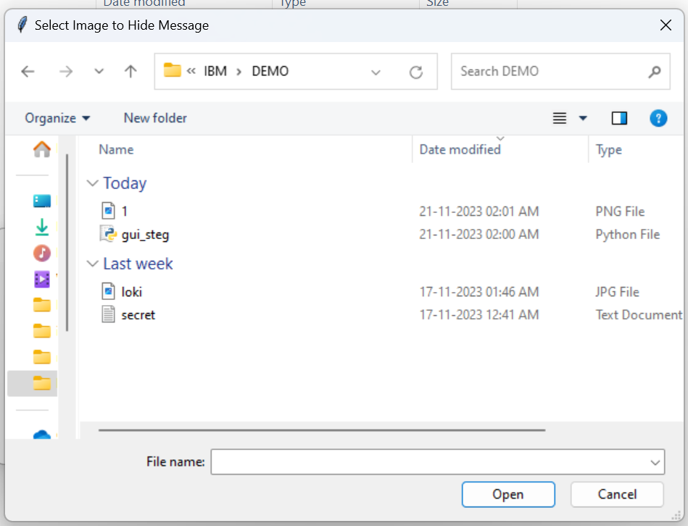
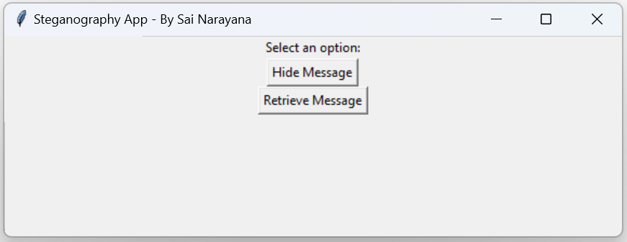
RESULT

Slide 13
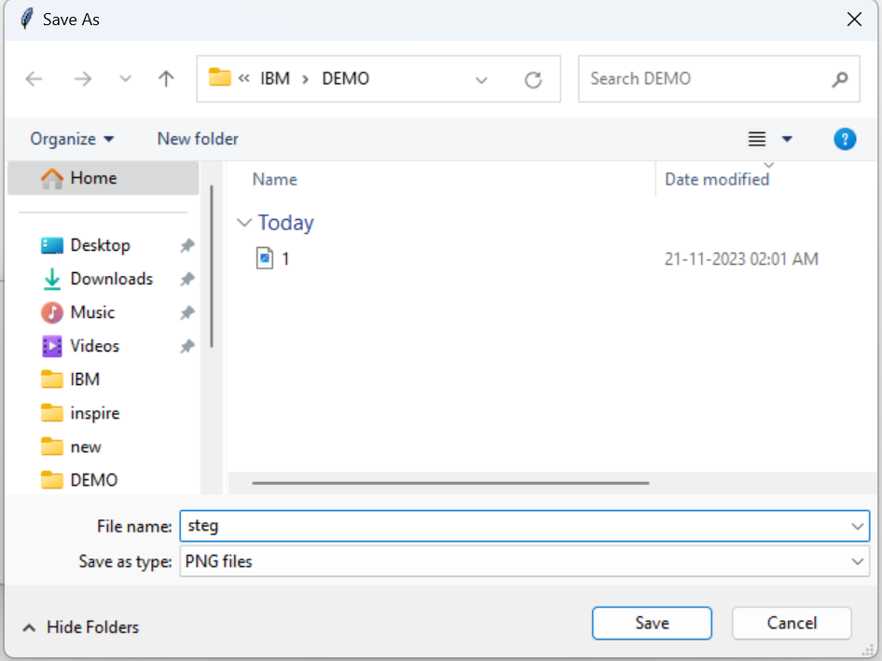
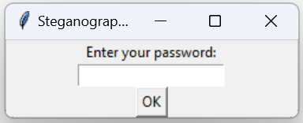

Slide 14
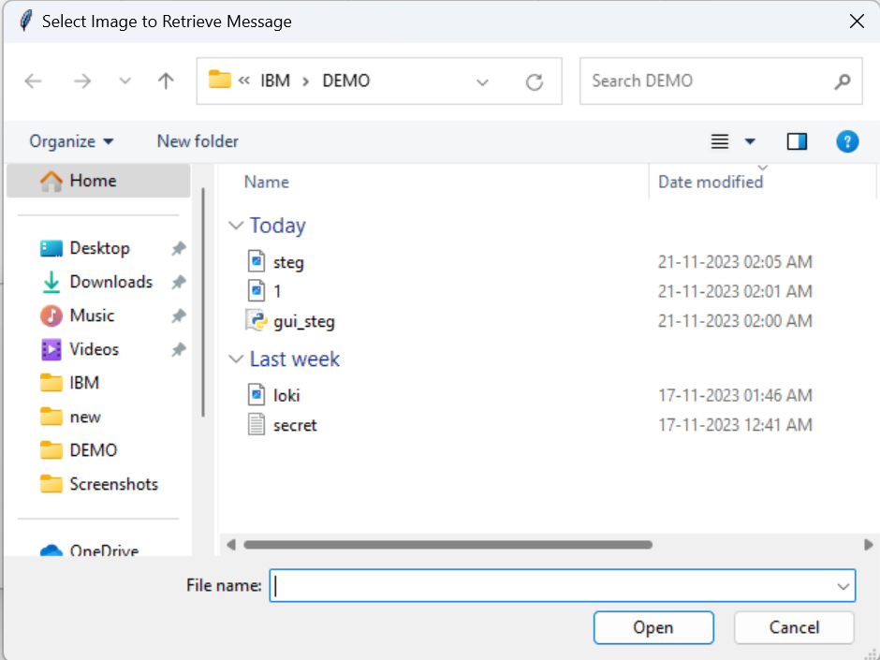
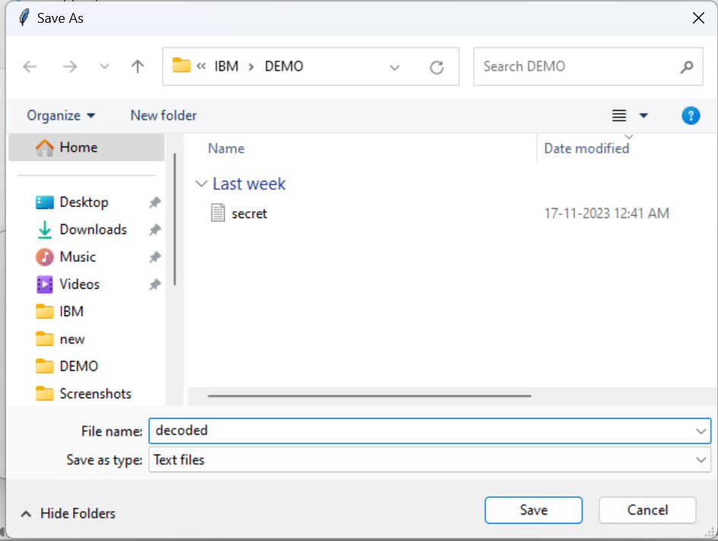

Slide 15
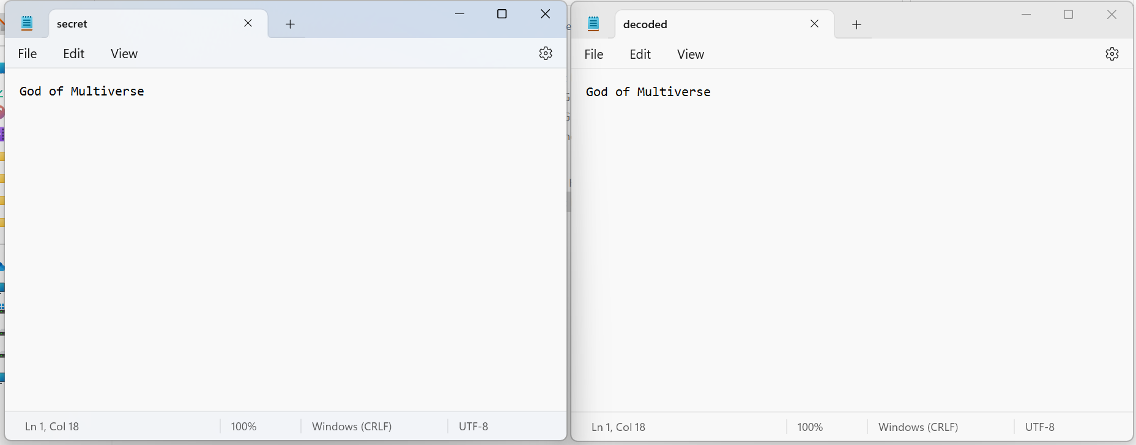

Slide 16
SOURCE CODE
https://github.com/sai231102/Image-Steganography-with-AES-Encryption

Slide 17
Links
https://medium.com/swlh/lsb-image-steganography-using-python-2bbbee2c69a2
https://towardsdatascience.com/hiding-data-in-an-image-image-steganography-using-python-e491b68b1372
https://onboardbase.com/blog/aes-encryption-decryption/
https://skillsbuild.edunetworld.com/courses/cs/steganography-hiding-message-in-an-image/

Slide 18


THANK YOU
Sai Narayana B
https://github.com/sai231102
https://www.linkedin.com/in/sai23

